Slide 1
Multiplying Fractions

Slide 2
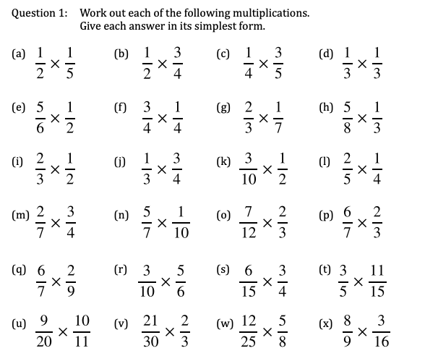
Multiplying Fractions Worksheet

Slide 3
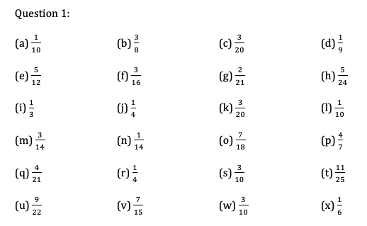
Multiplying Fractions Worksheet Answers

Slide 4
Two-Way Tables

Slide 5
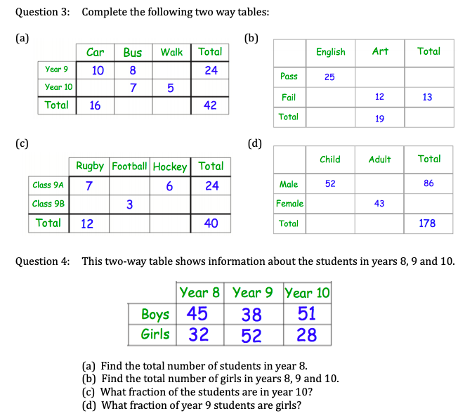
Two-Way Tables Worksheet

Slide 6
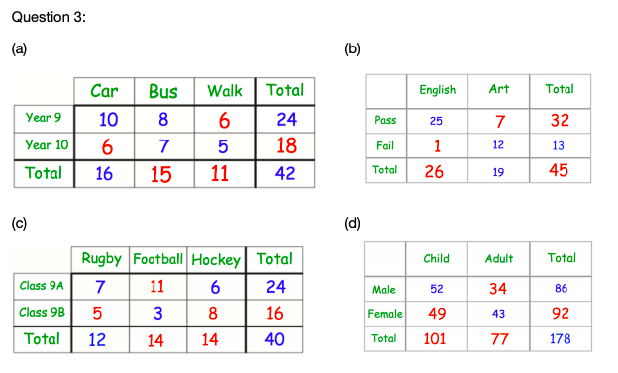
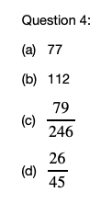
Two-Way Tables Worksheet Answers

Slide 7
Factorising Expressions

Slide 8
Factorising Expressions Worksheet

Slide 9
Factorising Expressions Worksheet Answers

Slide 10
Expanding Double Brackets

Slide 11
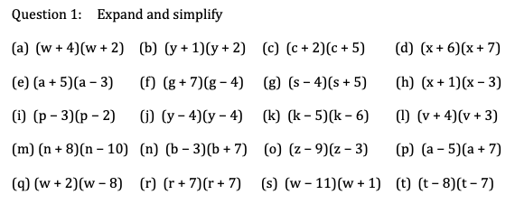
Expanding Brackets Worksheet

Slide 12
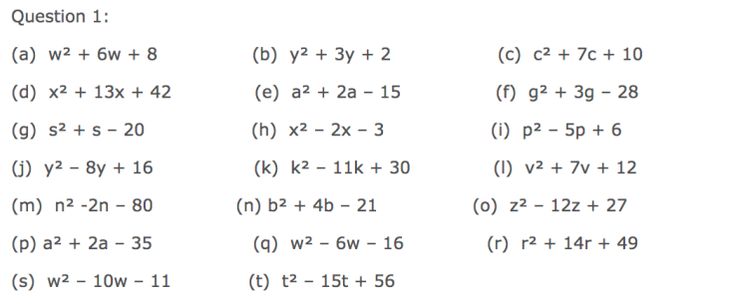
Expanding Brackets Worksheet Answers

